Slide 1
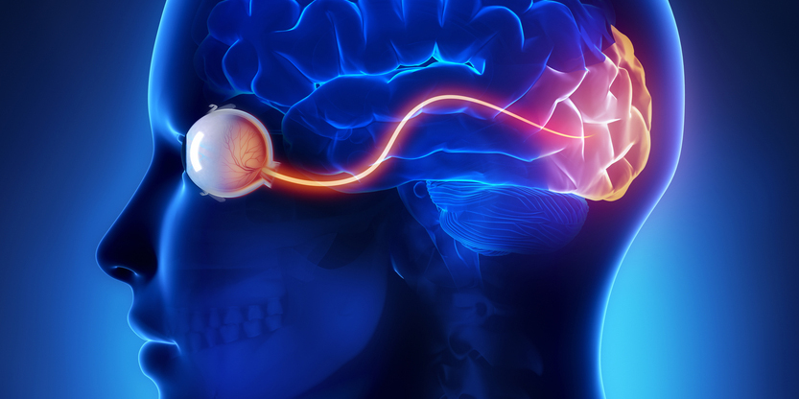
Supervised Learning – Artificial Neural Networks
Neural networks - collection of neurons are interconnected inspired by the functioning of the human brain.
Generally, when you open your eyes, what you see is called data and is processed by the Neurons(data processing cells) in your brain and recognizes what is around you.

Slide 2
Artificial Neural Networks
ANN’s are composed of many highly interconnected processing elements (neurons) working in unity to solve specific problems.
An ANN is configured for a specific application, such as pattern recognition or data classification, Image recognition, voice recognition through a learning process.

Slide 3
Input Layer:
As the name suggests, it accepts inputs in several different formats provided by the programmer.
Hidden Layer:
The hidden layer presents in-between input and output layers. It performs all the calculations to find hidden features and patterns.
Output Layer:
The input goes through a series of transformations using the hidden layer, which finally results in output that is conveyed using this layer.

Slide 4
For one single observation, x0, x1, x2, x3...x(n) represents various inputs(independent variables) to the network. Each of these inputs is multiplied by a connection weight or synapse. The weights are represented as w0, w1, w2, w3….w(n).
Weight shows the strength of a particular node.

Slide 5
b is a bias value. A bias value allows you to shift the activation function up or down.
In the simplest case, these products are summed, fed to a transfer function (activation function) to generate a result, and this result is sent as output.
Mathematically, x1.w1 + x2.w2 + x3.w3 ...... xn.wn = ∑ xi.wi
Now activation function is applied 𝜙(∑ xi.wi)

Slide 6
Activation function
The Activation function is important for an ANN to learn and make sense of something really complicated. Their main purpose is to convert an input signal of a node in an ANN to an output signal. This output signal is used as input to the next layer in the stack.
Activation function decides whether a neuron should be activated or not by calculating the weighted sum and further adding bias to it.

Slide 7
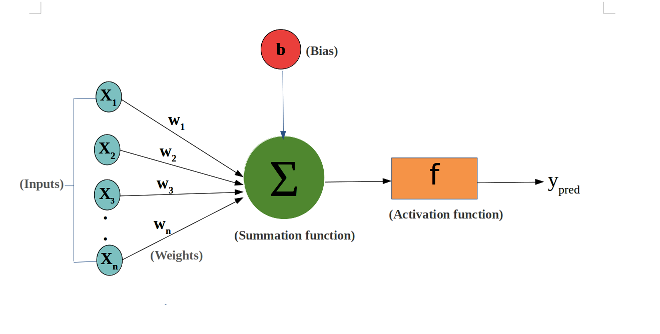
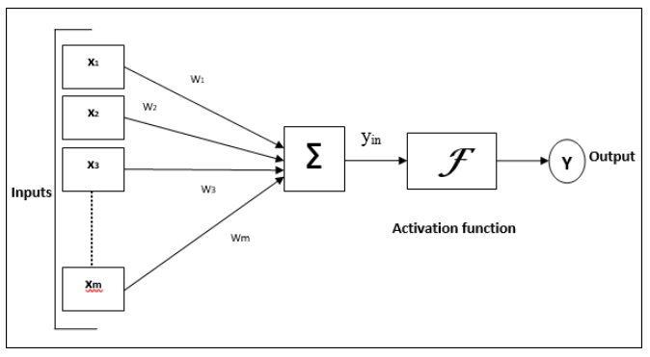

Model of Artificial Neural Network
Threshold Value

Slide 8
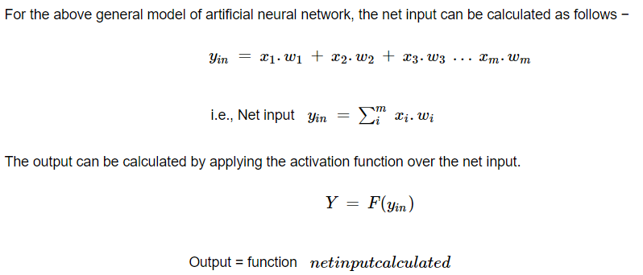
Cont..

Slide 9

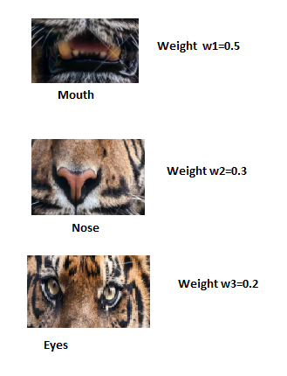
Example: Identify whether the animal is tiger or not
Assigning weight to Features based on training data

Slide 10

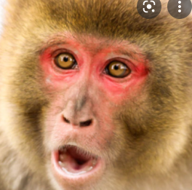
Test Data
Yin=x1w1+x2w2+x3w3
Yin= mouth*0.5+nose*0.3+eyes*0.2
Test Data:
Yin=0.8*0.5+0.9*0.3+0.75*0.2=0.82
Yin=0.4*0.5+0.3*0.3+0.25*0.2=0.34
Activation Function or threshold=0.5
If Yin (0.82) >=0.5 then Tiger
If Yin (0.34) <0.5 then not a tiger
 | Probability value
mouth | nose | eyes | class
0.8 | 0.9 | 0.75 | Tiger
0.4 | 0.3 | 0.25 | Monkey

Slide 11
Multi layer Neural Networks Back Propagation

Slide 12
Why do we need Back Propagation in Multi Layer Neural Networks ?
In a multi layer neural network, there will be one input layer, one output layer and one or more hidden layers.
Each and every node in the nth layer will be connected to each and every node in the (n-1)th layer.
So, the input from the input layer is multiplied with the associated weights of every link and will be traversed till the output layer for the final ouput.
In case of any error, we might need to update several weight vectors in many hidden layers.
This is where Back Propagation comes into place. It’s nothing but updation of the weight vectors in the hidden layers according to the training error or the loss produced in the ouput layer.

Slide 13
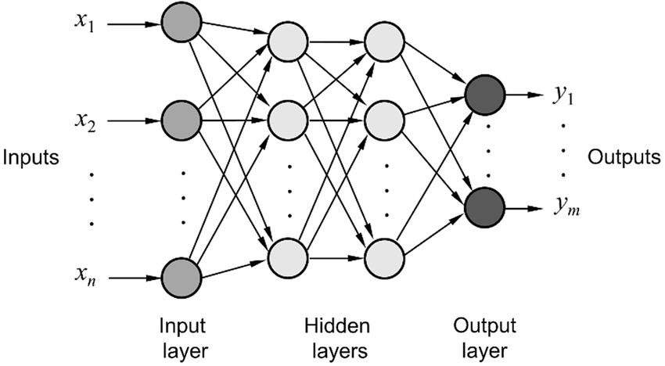
Representation of a Multi Layer Neural Network

Slide 14

BACK PROPAGATION ALGORITHM
The formula for calculating training error for a neural network can be represented as follows:
outputs is the set of output units in network
d is the data point
t and o are target values and the output values produced by the network for the kth output unit for data point ‘d’.

Slide 15
Step 1:The input layer receives the input.
Step 2:The input is then averaged overweight.
Step 3:Each hidden layer processes the output. Each output is referred to as “Error” here which is actually the difference between the actual output and the desired output.
Step 4:In this step, the algorithm moves back to the hidden layers again to optimize the weights and reduce the error.
The Backpropagation algorithm looks for the minimum value of the error function in weight space using a technique called the delta rule or gradient descent. The weights that minimize the error function is then considered to be a solution to the learning problem.

Slide 16
Consider the below table:
Input | Desired Output
0 | 0
1 | 2
2 | 4
The following table shows the output of the model when ‘W” value is 3:
Input | Desired Output | Model output (W=3)
0 | 0 | 0
1 | 2 | 3
2 | 4 | 6

Slide 17
The difference between the actual output and the desired output:
Input | Desired Output | Model output (W=3) | Absolute Error | Square Error
0 | 0 | 0 | 0 | 0
1 | 2 | 3 | 1 | 1
2 | 4 | 6 | 2 | 4
Let’s change the value of ‘W’. Notice the error when ‘W’ = ‘4’
Input | Desired Output | Model output (W=3) | Absolute Error | Square Error | Model output (W=4) | Absolute Error | Square Error
0 | 0 | 0 | 0 | 0 | 0 | 0 | 0
1 | 2 | 3 | 1 | 1 | 4 | 2 | 4
2 | 4 | 6 | 2 | 4 | 8 | 4 | 16

Slide 18
when we increase the value of ‘W’ the error has increased. So, obviously there is no point in increasing the value of ‘W’ further. But, what happens if we decrease the value of ‘W’? Consider the table below:
Input | Desired Output | Model output (W=3) | Absolute Error | Square Error | Model output (W=2) | Absolute Error | Square Error
0 | 0 | 0 | 0 | 0 | 0 | 0 | 0
1 | 2 | 3 | 2 | 4 | 2 | 0 | 0
2 | 4 | 6 | 2 | 4 | 4 | 0 | 0
Now, what we did here:
We first initialized some random value to ‘W’ and propagated forward.
Then, we noticed that there is some error. To reduce that error, we propagated backwards and increased the value of ‘W’.
After that, also we noticed that the error has increased. We came to know that, we can’t increase the ‘W’ value.
So, we again propagated backwards and we decreased ‘W’ value.
Now, we noticed that the error has reduced.

Slide 19
Updation of weights in Back Propagation
Back-propagation is the essence of neural net training. It is the practice of fine-tuning the weights of a neural net based on the error rate (i.e. loss) obtained in the previous epoch (i.e. iteration). Proper tuning of the weights ensures lower error rates, making the model reliable by increasing its generalization.

Slide 20
Applications of Neural Networks
1. Facial Recognition
Facial Recognition Systems are serving as robust systems of surveillance. Recognition Systems matches the human face and compares it with the digital images. They are used in offices for selective entries. The systems thus authenticate a human face and match it up with the list of IDs that are present in its database.

Slide 21
2. Stock Market Prediction
To make a successful stock prediction in real time a Multilayer Perceptron MLP (class of feedforward artificial intelligence algorithm) is employed. MLP comprises multiple layers of nodes, each of these layers is fully connected to the succeeding nodes. Stock’s past performances, annual returns, and non profit ratios are considered for building the MLP model.

Slide 22
3. Social Media
Artificial Neural Networks are used to study the behaviours of social media users. Data shared everyday via virtual conversations is tacked up and analyzed for competitive analysis.

Slide 23
4. Aerospace
Aerospace Engineering is an expansive term that covers developments in spacecraft and aircraft. Fault diagnosis, high performance auto piloting, securing the aircraft control systems, and modeling key dynamic simulations are some of the key areas that neural networks have taken over.

Slide 24
5. Defence
Defence is the backbone of every country. Every country’s state in the international domain is assessed by its military operations. Neural Networks also shape the defence operations of technologically advanced countries. The United States of America, Britain, and Japan are some countries that use artificial neural networks for developing an active defence strategy.

Slide 25
6. Healthcare
Convolutional Neural Networks are actively employed in the healthcare industry for X ray detection, CT Scan and ultrasound.
As CNN is used in image processing, the medical imaging data retrieved from aforementioned tests is analyzed and assessed based on neural network models. Recurrent Neural Network (RNN) is also being employed for the development of voice recognition systems.

Slide 26
7. Signature Verification and Handwriting Analysis
Artificial Neural Networks are used for verifying the signatures. ANN are trained to recognize the difference between real and forged signatures. ANNs can be used for the verification of both offline and online signatures.

Slide 27
8. Weather Forecasting
Multilayer Perceptron (MLP), Convolutional Neural Network (CNN) and Recurrent Neural Networks (RNN) are used for weather forecasting. Traditional ANN multilayer models can also be used to predict climatic conditions 15 days in advance. A combination of different types of neural network architecture can be used to predict air temperatures.

Slide 28
https://machinelearningmastery.com/implement-backpropagation-algorithm-scratch-python/
https://www.askpython.com/python/examples/backpropagation-in-python

Slide 29
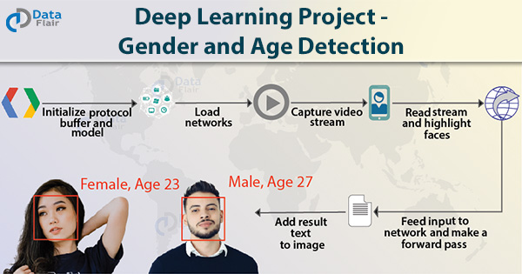
Machine Learning / Deep Learning Project ideas
1. Gender and Age Detection
Deep Learning Project Idea – You might have seen many smartphone cameras are now equipped with AI. They can even predict if a person is a male or female and their age. This can be done with deep learning but we will need a good amount of data to make this model.

Slide 30

2. Driver Drowsiness Detection
The driver drowsiness detection is a project which can detect whether a person is sleeping or not. We can implement a model for drivers and it can also prevent accidents from happening.

Slide 31

3. Language Translator
Deep Learning Project Idea – Human beings take about a year to learn a language but computers can learn in a day. In this project, we can build a language translator app that can translate from English to the French language.

